Slide 1
CS6907-12: Big Data and Analytics
Spring 2016
Stephen H. Kaisler, D.Sc.
Lecture 4 – R w/ Analytics

Slide 2
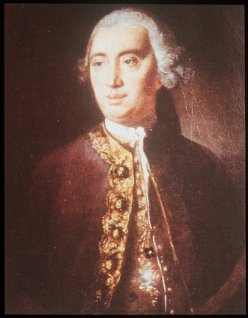
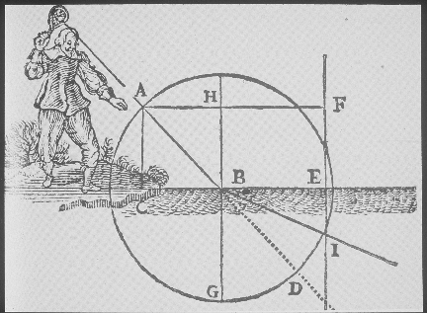
Descriptive Analytics
We are focused on causation: what events or factors caused (e.g., explain) some other event or situation.
Physicists discovered many useful laws:
  Snell’s Law
  Hooke’s Law
  Olm’s Law
  Joule’s Law
All used equations to describe how the world actually works
David Hume
CSCI 6907-12 Big Data and Analytics
4-<number>

Slide 3
Why Do We Model?
To overcome linear thinking: We cannot understand how the various parts of the system interact and add up to the whole
To discover the space of behaviors and cascading effects that real social systems can realize
To foresee novel events that our mental models cannot even imagine
To conduct virtual experiments on simulated social worlds on many scales
In summary, we model for three key reasons:
To gain insights into key variables and their causes and effects
To construct reasonable arguments as to why events can or cannot occur based on the model
To make qualitative or quantitative predictions about the future
CSCI 6907-12 Big Data and Analytics
4-<number>

Slide 4
Cause and Effect
According to Hume, causation is a learnable habit of the mind:
  When we see that two things go together, we learn that one “causes” the other (but,… caution about spurious correlations)
  When the flame burns us, we learn to keep away from it
In our everyday lives, we generally assume that people express rational behavior.
  Certainly, driving one’s car to work in Washington, D.C. is an example.
  People react to changes in the world in a way that is in their best interests, privately
  People generally learn cause and effect, and seek to optimize (Simon: “satisfice”) them for their own benefit
Simon’s principle: Social complexity is the result of (is caused by) the behavior of simple actors as they adapt to their complex environments
CSCI 6907-12 Big Data and Analytics
4-<number>

Slide 5
Causality
Equations Aren't Enough!
  Some social scientists just throw all their data into one massive regression equation, hoping that it will somehow control for all the variables.
Need to understand causality in order to understand how the world works
  Or, if we want to change the world
Experiments are the only guaranteed way to prove a causal model.
BUT: experiments cannot be done on many (most?) important social science problems
SO: we approximate them as best we can with correlational data, AND simulations
Computational simulations are powerful experimental tools for social scientists, just as they are for physical scientists (e.g., astronomy)
Judea Pearl, The Art and Science of Cause and Effect
CSCI 6907-12 Big Data and Analytics
4-<number>

Slide 6
Cluster Analysis
Cluster analysis is a technique sued to detect subgroups within a larger set of data
Common Steps:
  Choose Appropriate Attributes
  Scale the Data
  Screen for Outliers
  Calculate Distances
  Select a Clustering Algorithm
  Obtain One or More Cluster Solutions
  Determine # Clusters Present
  Obtain Final Clustering Solution
  Visualize The Results
  Interpret the Clusters
  Validate The Clusters
CSCI 6907-12 Big Data and Analytics
4-<number>

Slide 7
Cluster Analysis - I
Choose appropriate attributes;
  Look for attributes that differentiate items in the set
  A sophisticated cluster analysis cannot compensate for a poor choice of variables
Scale the data
  If the variables vary in range, the variables with the largest values will predominate and skew results
  Normalize (standardize) variables to a range [0…1] with standard deviation of 1.
  Other techniques may apply
Screen for outliers:
  Many clustering techniques are sensitive to outliers
  Use the outliers package to assist you (or, mvouttlier for multivariate
  outliers
  Use clustering technique robust in presence of outliers
CSCI 6907-12 Big Data and Analytics
4-<number>

Slide 8
Cluster Analysis – II
Calculate distances:
  Select a distance measure: Euclidean, Manhattan, Minkowski, and so on.
Select a clustering algorithm:
  Hierarchical clustering is good for a few hundred observations
  Partitioning methods handle much larger data sets
Apply the clustering algorithm varying the parameters:
Determine # clusters present:
  Tough problem, no generic solutions
  Domain knowledge helpful
  Use the NbClust package which has 30 indices
Obtain a final clustering solution:
  Perform a final clustering with the best set of parameters
  There is NO optimal solution, usually
CSCI 6907-12 Big Data and Analytics
4-<number>

Slide 9
Cluster Analysis – III
Visualize the results:
  Hierarchical clustering usually displayed as a dendrogram
  Partitioning clustering usually displayed as bivariate cluster plot
  You may have to select pairs of variables to plot (latter case)
Interpret the clusters:
  Examining the clusters, find what is common and what is not
  Requires domain knowledge
  Obtain summary statistics
  If categorical variables, look at modes and/or category distributions
Validate the results:
  Are these groupings represented in the real world in some way?
  If a different clustering method was used, would the same clusters be obtained?
  Try the fpc, clv, and clValid packages
CSCI 6907-12 Big Data and Analytics
4-<number>

Slide 10
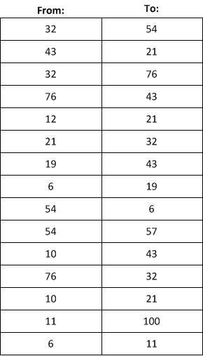
Cluster Analysis
You will have to prepare a data set for doing cluster analysis
Map all names of individuals that you have from Project #1 to integers
Create a 2-column matrix with labels From: and To:
Insert into the matrix the From:-To: pairs that you identified in project #1
Add in Topic: as another attribute
You should have a two-column vector with hundreds of entries
CSCI 6907-12 Big Data and Analytics
4-<number>

Slide 11
K-means Clustering - I
Basic Algorithm:
  Select K centroids
    Pick rows at random from your vector
    # rows depends on # clusters to start with
  Assign each data point to its closest centroid using a distance metric (following slides)
  Recalculate the centroids as the average of all data points in a cluster
    Centroids are p-length means vectors ( p = #attributes)
  Assign data points to their closest centroids
  Continue steps 3 and 4 until no re-assignments, or some maximum number of iterations reached
    R uses 10 as the default # iterations
CSCI 6907-12 Big Data and Analytics
4-<number>

Slide 12
K-means Clustering - II
Formula:
  ss(k) = Σ_{i=1}^{n} Σ_{j=0}^{p} (x_{ij} –x_{kj})²
Call: kmeans(matrix, centers)
  Matrix: a numeric dataset as a matrix or data frame
  Centers: # clusters to return
  Because it uses random seeding, you will get a different solution each call
  To ensure reproducibility, use set.seed(…) to set the random number generator seed
Use the NbClust package
Clustering used to identify subgroups within a data set
CSCI 6907-12 Big Data and Analytics
4-<number>

Slide 13
Matrix Operations - I
row1<- c(32, 43, 32, 76, 12, 21, 19, 6, 54, 54, 10, 76, 10, 11, 6, 23, 51, 45)
row2 <-c(54, 21, 76, 43, 21, 32, 43, 19, 6, 57, 43, 32, 21, 100, 11, 54, 12, 19)
row1
[1] 32 43 32 76 12 21 19 6 54 54 10 76 10 11 6 23 51 45
Row2
[1] 54 21 76 43 21 32 43 19 6 57 43 32 21 100 11 54 12 19
matrix<-rbind(row1,row2)
matrix
[,1] [,2] [,3] [,4] [,5] [,6] [,7] [,8] [,9] [,10] [,11] [,12] [,13] [,14] [,15] [,16] [,17] [,18]
row1 32 43 32 76 12 21 19 6 54 54 10 76 10 11 6 23 51 45
row2 54 21 76 43 21 32 43 19 6 57 43 32 21 100 11 54 12 19
t(matrix)
row1 row2
[1,] 32 54
[2,] 43 21
[3,] 32 76
[4,] 76 43
[5,] 12 21
[6,] 21 32
[7,] 19 43
[8,] 6 19
[9,] 54 6
[10,] 54 57
[11,] 10 43
[12,] 76 32
----- more
Transpose operation
CSCI 6907-12 Big Data and Analytics
4-<number>

Slide 14
K-means Clustering - III
Creating a data frame from a matrix
matrix.df <- as.data.frame(matrix)
matrix.df
V1 V2 V3 V4 V5 V6 V7 V8 V9 V10 V11 V12 V13 V14 V15 V16 V17 V18
row1 32 43 32 76 12 21 19 6 54 54 10 76 10 11 6 23 51 45
row2 54 21 76 43 21 32 43 19 6 57 43 32 21 100 11 54 12 19
kc <- kmeans(tmatrix, 3, nstart=5)
kc
K-means clustering with 3 clusters of sizes 7, 6, 5
Cluster means:
row1 row2
12.0 27.14286
57.5 22.16667
30.4 68.20000
Clustering vector: [1] 3 2 3 2 1 1 1 1 2 3 1 2 1 3 1 3 2 2
Within cluster sum of squares by cluster:
[1] 1138.857 2012.333 2594.000
(between_SS / total_SS = 70.3 %)
Available components: [1] "cluster" "centers" "totss" "withinss" "tot.withinss" "betweenss" "size" [8] "iter" "ifault"
CSCI 6907-12 Big Data and Analytics
4-<number>

Slide 15
K-means Clustering - IV
result<-NbClust(data=tmatrix, diss=NULL, distance="euclidean", min.nc = 3
max.nc=6, method="kmeans", index="all")
*** : The Hubert index is a graphical method of determining the number of clusters.
In the plot of Hubert index, we seek a significant knee that corresponds to a significant increase of the value of the measure i.e the significant peak in Hubert index second differences plot.
*** : The D index is a graphical method of determining the number of clusters. In the plot of D index, we seek a significant knee (the significant peak in Dindex second differences plot) that corresponds to a significant increase of the value of the measure.
*******************************************************************
* Among all indices:
* 5 proposed 3 as the best number of clusters
* 4 proposed 4 as the best number of clusters
* 13 proposed 6 as the best number of clusters
***** Conclusion ***** *
According to the majority rule, the best number of clusters is 6
CSCI 6907-12 Big Data and Analytics
4-<number>

Slide 16
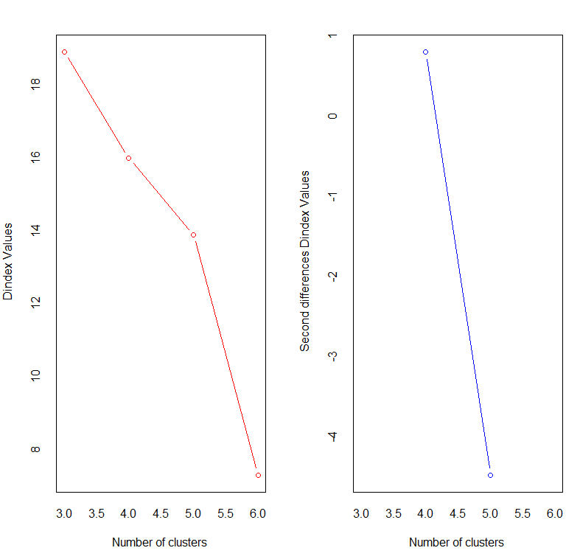
K-means Clustering - V
CSCI 6907-12 Big Data and Analytics
4-<number>

Slide 17
More Clustering - I
Datasets: mpgData-01.txt, headers.txt
207 records of cars with the following attributes:
  Mpg: miles per gallon
  Cylinders: # cylinders
  Displacement: in cubic inches
  Hp: horsepower
  Weight: in pounds
  Acceleration: time to go 0-60 in seconds
  Make&Model: manufacturer and specific model
CSCI 6907-12 Big Data and Analytics
4-<number>

Slide 18
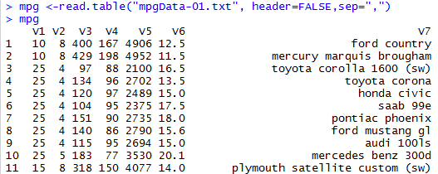

More Clustering - II
Read in the data
Print mpg again and you will see the field names attached to the columns
CSCI 6907-12 Big Data and Analytics
4-<number>

Slide 19
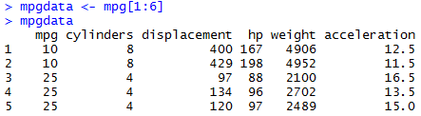
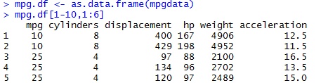
More Clustering – III
Extract the make&model from mpg to a separate array
And, extract just the numeric data into another array
Make a dataframe because we will need it
CSCI 6907-12 Big Data and Analytics
4-<number>

Slide 20
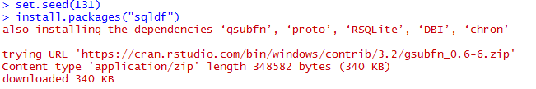

More Clustering – IV
Set a seed for random number generator, so results are reproducible
Install sqldf so you can sql statements to query the data
More stuff omitted after 340 KB (you’ll see it when you load it!)
Declare it a library so R can find it!
Always do this after installing a package
CSCI 6907-12 Big Data and Analytics
4-<number>

Slide 21
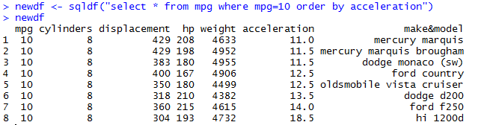
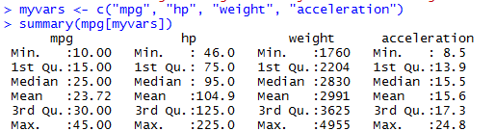
More Clustering – V
An example of sqldf for you SQL aficionados
Descriptive Statistics
CSCI 6907-12 Big Data and Analytics
4-<number>

Slide 22
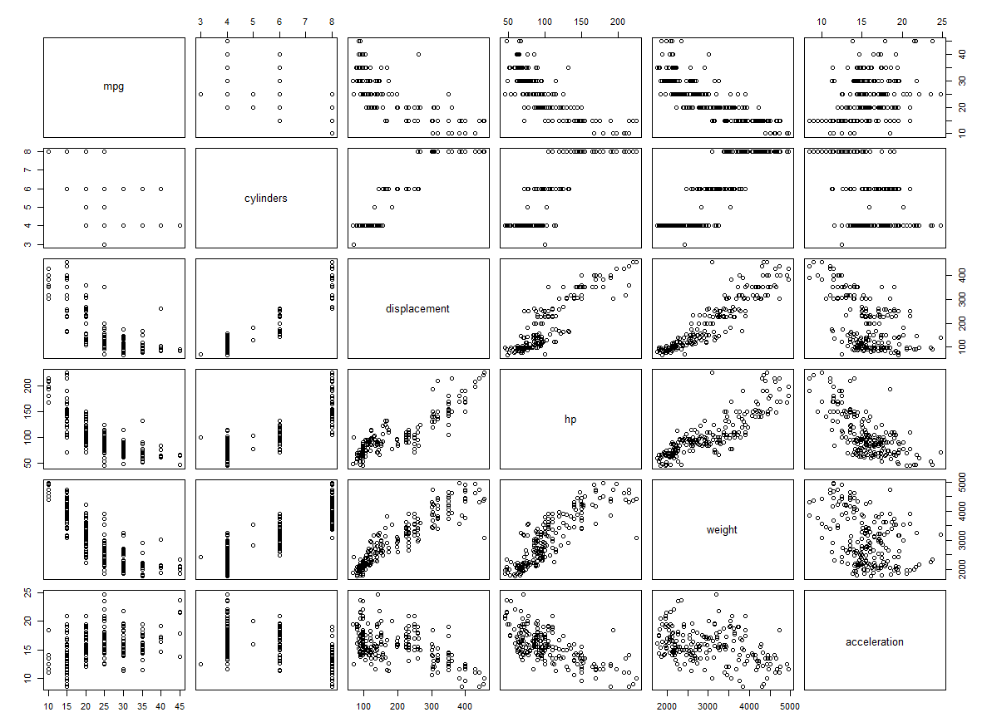
More Clustering – VI
A plot of mpg.df
CSCI 6907-12 Big Data and Analytics
4-<number>

Slide 23
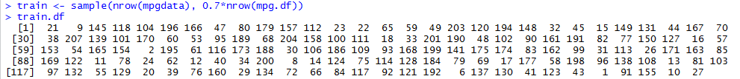
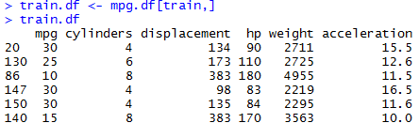
More Clustering – VII
Let’s create a training data setby selection 70& of the records in mpg.df
  Sample mpgdata (just the numeric data!)
  Take 70% of the rows
  train.df contains the row index
Now, select those rows from mpg.df
Row index
CSCI 6907-12 Big Data and Analytics
4-<number>

Slide 24
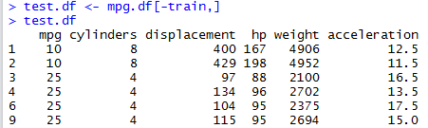
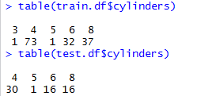
More Clustering - VIII
And, also the validation/test records
  -train says select those records whose indices are NOT in train
How many of each number of cylinders are there?
CSCI 6907-12 Big Data and Analytics
4-<number>

Slide 25
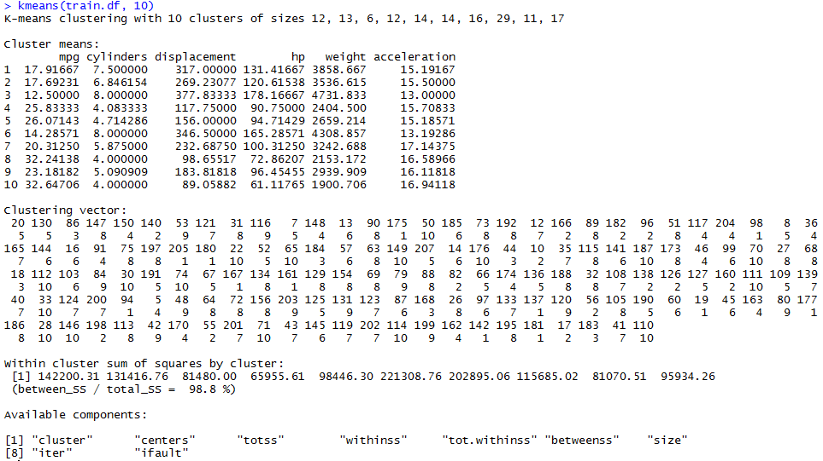
More Clustering - IX
Mean of the cluster elements for each cluster!
CSCI 6907-12 Big Data and Analytics
4-<number>

Slide 26
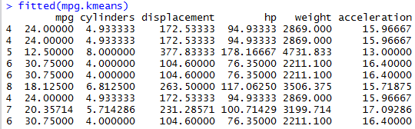
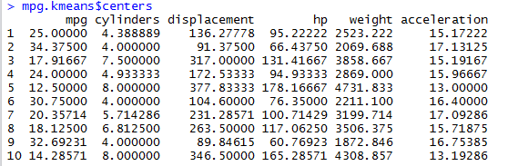
More Clustering - X
You can which cluster each point belongs to:
To see the 10 cluster’s centers, use
CSCI 6907-12 Big Data and Analytics
4-<number>

Slide 27
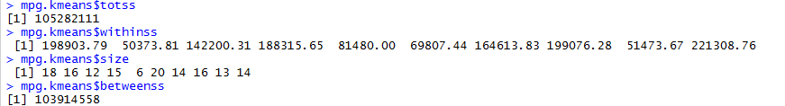
More Clustering - XI
cluster | A vector of integers (from 1:k) indicating the cluster to which each point is allocated.
centers | A matrix of cluster centres.
totss | The total sum of squares.
withinss | Vector of within-cluster sum of squares, one component per cluster.
tot.withinss | Total within-cluster sum of squares, i.e. sum(withinss).
betweenss | The between-cluster sum of squares, i.e. totss-tot.withinss.
size | The number of points in each cluster.
Install the NbClust package
CSCI 6907-12 Big Data and Analytics
4-<number>

Slide 28
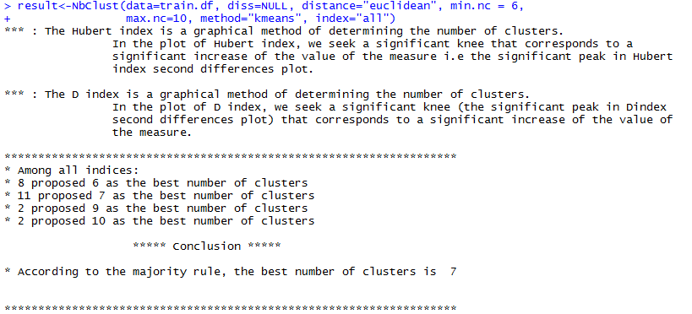
More Clustering - XII
CSCI 6907-12 Big Data and Analytics
4-<number>

Slide 29
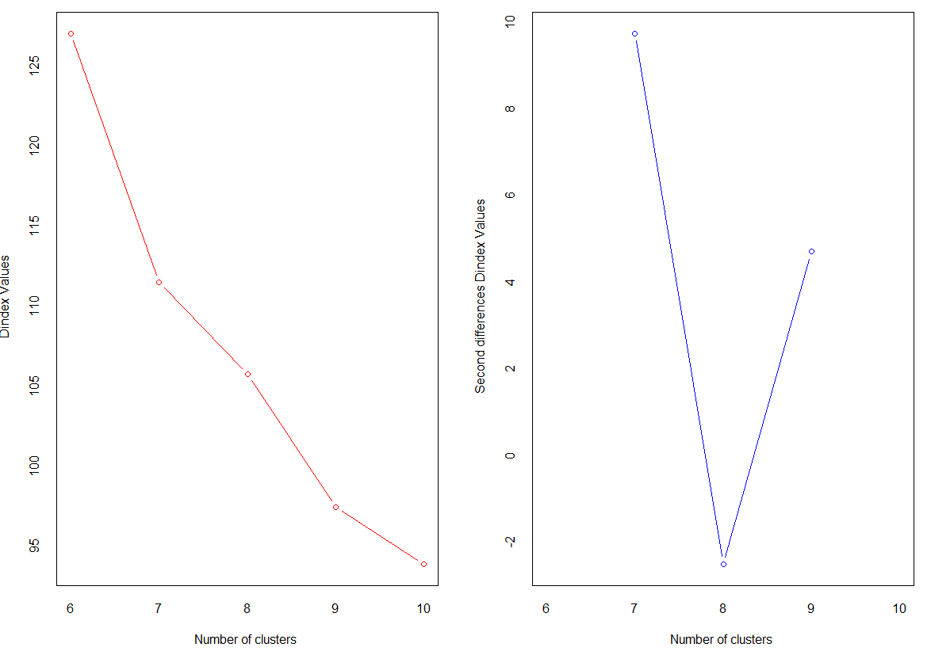
More Clustering - XIII
“The knee”
Why? Knee at 7 has more acute tangent
CSCI 6907-12 Big Data and Analytics
4-<number>

Slide 30
More Clustering - XIV
Each cluster is represented by its most representative object:
  This object is the one whose average dissimilarity to all the objects in the cluster is minimal.
  A medoid is always a member of the data set, whereas the value of the centroid may not be that of any object in the data set.
  A more robust solution to clustering is provide by the partitioning around medoids (PAM) algorithm to be found in the cluster package.
  After finding the k medoids, clusters are built around these medoids.
  PAM can use any distance measure.
CSCI 6907-12 Big Data and Analytics
4-<number>

Slide 31
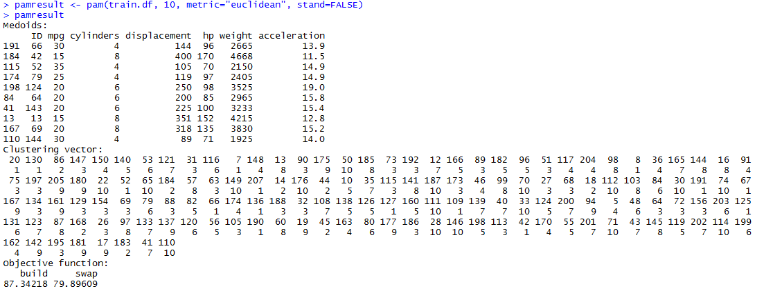
Partitioning Around Medoids (PAM)
Medoids are the representative objects for each class.
Clustering vector: for each row there are two components: the observation number (upper level) and the cluster to which it belongs (lower level)
So, observation 20 belongs to cluster 1.
Compare these with previous cluster assignments by Kmeans
CSCI 6907-12 Big Data and Analytics
4-<number>

Slide 32
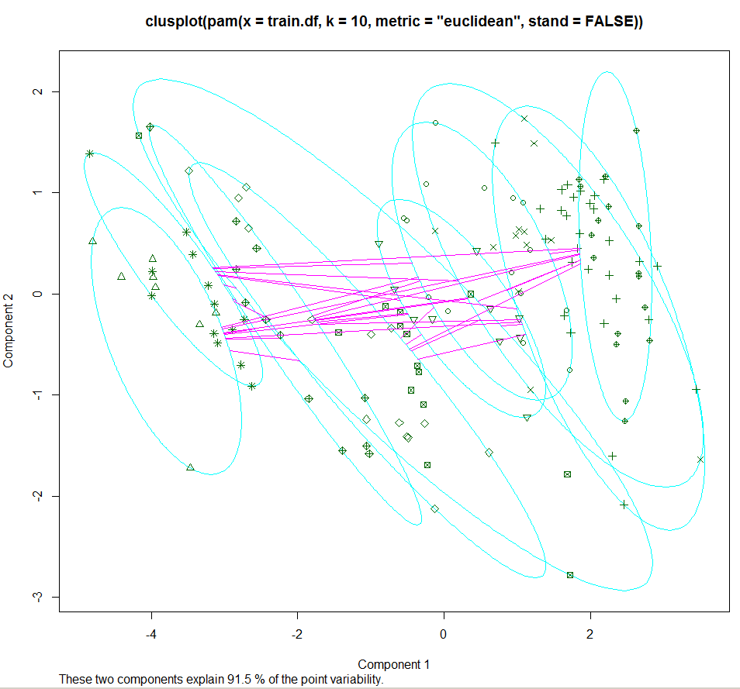
Using clusplot to Depict PAM
CSCI 6907-12 Big Data and Analytics
4-<number>

Slide 33
Data Reduction
The mushroom data set has over 8000 observations with 22 attributes.
This can make for some complex processing since not all attributes will necessarily contribute to a partitioning of the data set into three classes.
So, to make the problem more tractable, you may need to reduce the dimensionality by eliminating some of the attributes.
The problem is how to determine which attributes contribute the least to determining the members of the unsure class (see project description).
CSCI 6907-12 Big Data and Analytics
4-<number>

Slide 34
Data Reduction Techniques
Principal Components Analysis is a data reduction technique that reduces the number of variables in a data set for easier explanation
  use principal() in the psych package
  The principal components are linear combinations of the observed variables
  The principal components are orthogonal to each other (think vector spaces)
Exploratory Factor Analysis seeks to uncover the latent structure in a give set of variables
  Use factanal()
Both techniques obtain their solutions by seeking correlations among the observed variables.
CSCI 6907-12 Big Data and Analytics
4-<number>

Slide 35
Principal Component Analysis
Need to decide how many components to extract:
  Based in prior experience and theory
  Selecting # components needed to account for some threshold of variance
  Selecting # of components by inspecting eigenvalues of the k x k correlation matrix.
Why reduce dimensionality?
  Reduce time complexity: less computation
  Reduce space complexity: less parameters
  Don’t have to observe eliminated features
  Simpler models more robust on smaller data sets
  Simple explanations often good enough
  Can plot data in 2- or 3-D visualizations; more understandable
CSCI 6907-12 Big Data and Analytics
4-<number>

Slide 36
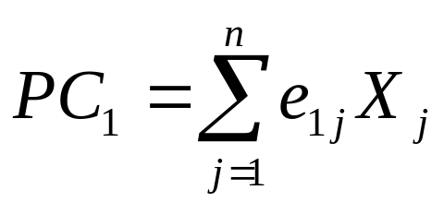
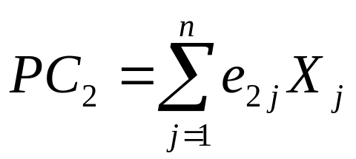
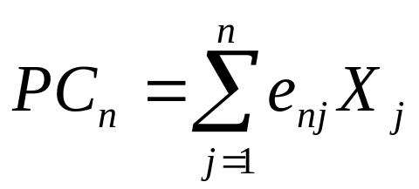
Principal Component Analysis
Each principal component is a weighted sum of all the X’s:
The e’s are called eigenvectors
Principal components are new variables that are not correlated with each other.
The principal components transformation is equivalent to a rotation of axes.
. . .
CSCI 6907-12 Big Data and Analytics
4-<number>

Slide 37
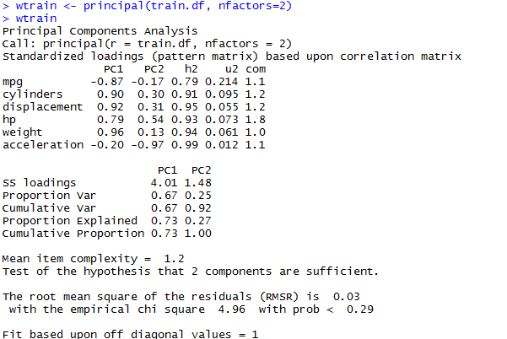
Principal Components Analysis - I
CSCI 6907-12 Big Data and Analytics
4-<number>

Slide 38
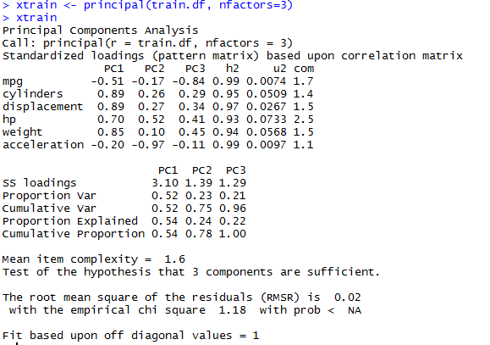
Principal Component Analysis - II
CSCI 6907-12 Big Data and Analytics
4-<number>

Slide 39
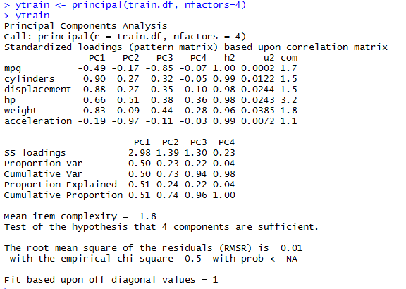
Principal Component Analysis - III
CSCI 6907-12 Big Data and Analytics
4-<number>

Slide 40
Principal Components Analysis
Principal() does an eigen value decomposition and returns eigen values, loadings, and degree of fit for a specified number of components.
Principal results:
  PCx contains the principal component loadings, which are the correlations of the observed variables with the principal components
  Same for PCx since we extracted three factors
  Returns a subset of just the best nfactors.
  SS contains the eigenvalues associated with the components
  ProportionVar is the amount of variance accounted for by each component.
  Notice: χ² is trending towards 0 as # factors increases.
CSCI 6907-12 Big Data and Analytics
4-<number>

Slide 41
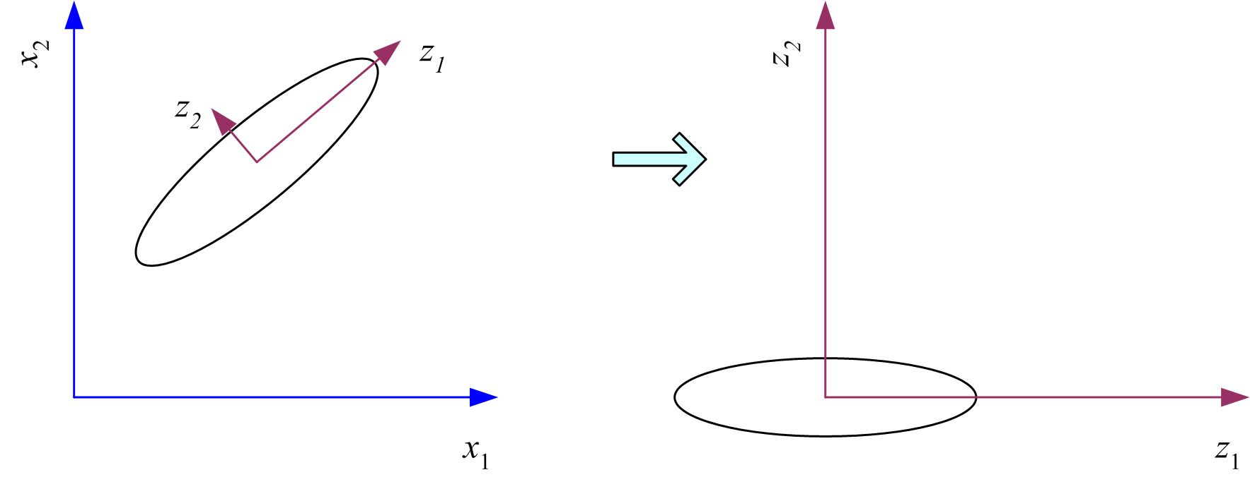
Principal Component Analysis
A technique for mapping a multidimensional space to 2 or 3 dimensions
Given vector x, its projection on some axis w is z = W^{T}(x – m)
Maximize var(Z) by choosing eigenvectors as new dimension’s bases
Var(z) = w^{T} E[(x – μ)(x –μ)^{T}]w = w^{T} ∑ w
Var(x)= E[(x – μ)(x –μ)^{T}] = ∑
The eigenvectors (weights) are based solely on the intercorrelations among the X’s and have no knowledge of Y
Center data at origin and rotate axes - improve understanding
CSCI 6907-12 Big Data and Analytics
4-<number>

Slide 42
PCA: A Factor Analysis Model
Factor Analysis: a class of procedures primarily used for data reduction and summarization.
  Used to identify underlying dimensions, or factors, that explain the correlations among a set of variables.
Each variable is expressed as a linear combination of underlying factors.
X_{i} = A_{i 1}F₁ + A_{i 2}F₂ + A_{i 3}F₃ + . . . + A_{im}F_{m} + V_{i}U_{i}
where
X_{i} = i th standardized variable
A_{ij} = standardized multiple regression coefficient of variable i on common factor j
F_{i} = common factor
V_{i} = standardized regression coefficient of variable i on unique factor i
U_{i} = the unique factor for variable i
m = number of common factors
CSCI 6907-12 Big Data and Analytics
4-<number>

Slide 43
PCA: A Factor Analysis Model
Unique factors are uncorrelated with each other and with the common factors.
Common factors are expressed as linear combinations of the observed variables X_{i}
F_{i} = W_{i1}X₁ + W_{i2}X₂ + W_{i3}X₃ + . . . + W_{ik}X_{k}
where
F_{i} = estimate of i th factor
W_{i} = weight or factor score coefficient
k = number of variables
CSCI 6907-12 Big Data and Analytics
4-<number>

Slide 44
PCA: Eigenvectors
With n dimensions, there will be n eigenvectors.
Each eigenvalue has an associated eigenvector.
  An eigenvalue is the length of an axis, the eigenvector determines its orientation in space.
Once the eigenvectors are ordered highest to lowest, smaller eigenvectors in the rightmost columns can be dropped without (usually) significant loss of information.
A feature vector is a vector of the eigenvectors that were computed:
Feature vector = (eig1, eig2, eig3, …., eign)
Finally, the final data set is computed by taking the transpose of the feature vector times the transpose of the data matrix.
Final data set = FV^{T} * ADS^{T}
CSCI 6907-12 Big Data and Analytics
4-<number>

Slide 45
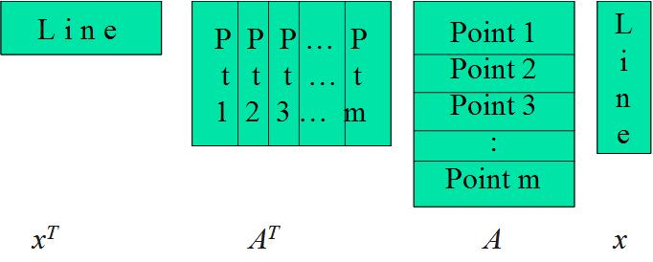
PCA - Algebraic Formulation
Express in matrix form:
Sum of squares is:
max( x^{T}A^{T} Ax), subject to x^{T}x = 1
x^{T}A^{T}Ax = e = e x^{T}x = x^{T} (ex)
<=> x^{T} (A^{T}Ax – ex) = 0
x is an eigenvector and e an
eigenvalue if
ex=(A^{T}A)x
x
CSCI 6907-12 Big Data and Analytics
4-<number>

Slide 46
PCA - Algebraic Formulation
How many eigenvectors are there?
Except in degenerate cases when eigenvalues repeat, there are n eigenvectors
  x₁…x_{n} are the eigenvectors
  e₁…e_{n} are the eigenvalues
All eigenvectors are mutually orthogonal and therefore form a new basis
Eigenvectors corresponding to the same eigenvalue have the property that any linear combination is also an eigenvector with the same eigenvalue; one can then find as many orthogonal eigenvectors as the number of repeats of the eigenvalue.
Since the eigenvectors form a basis:
  (A^{T} A) y =(A^{T}A) (a₁x₁+a₂x₂……..+a_{n}x_{n}) =a₁e₁x₁+….+a_{n}e_{n}x_{n}
  (A^{T} A)(A^{T} A) y=a₁e₁e₁x₁+….+a_{n}e_{n}e_{n} x_{n}
CSCI 6907-12 Big Data and Analytics
4-<number>

Slide 47
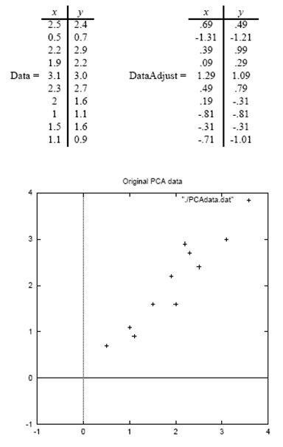

PCA – Simple Procedure
Original data consists of two dimensions.
Step 1: Subtract the mean from each of the data dimensions to produce a data set whose mean is zero.
Step 2 - Calculate the covariance matrix
Because only 2D, the CM is a 2 x matrix.
Non-diagonal elements are positive, so both x and y increase together (see plot)
Ref: Lindsay I. Smith, A Tutorial on Principal Components Analysis
CSCI 6907-12 Big Data and Analytics
4-<number>

Slide 48
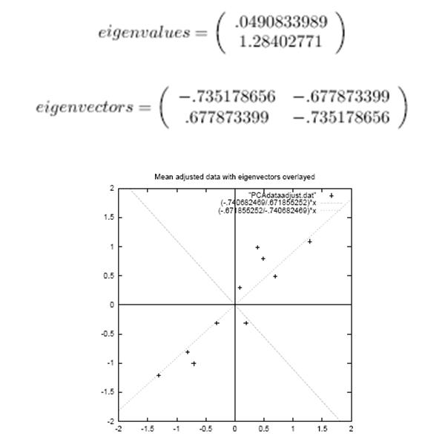
PCA – Simple Procedure
Step 3 - Calculate the eigenvalues and eigenvectors of the covariance matrix
  Since the covariance matrix is square, we can calculate the eigenvalues and eigenvectors
  The eigenvector with the highest eigenvalue is the principle component of the data set
  Eigenvector (1) shows linear relationship among data points
  Eigenvector (2) shows that data points all follow a linear path, but are removed by some distance
Now, characterize the data using the eigenvectors to make it more understandable
(1)
(2)
CSCI 6907-12 Big Data and Analytics
4-<number>

Slide 49
PCA – Simple Procedure
Step 4 – Derive the new data
FinalData = RowFeatureVector x RowZeroMeanData
RowFeatureVector is the matrix with the eigenvectors in the columns transposed so that the eigenvectors are now in the rows, with the most significant eigenvector at the top
RowZeroMeanData is the mean-adjusted data transposed, i.e., the data items are in each column, with each row holding a separate dimension.
FinalData is the final data set, with data items in columns, and dimensions along rows.
What will this give us? It will give us the original data solely in terms of the vectors we chose.
To get original data back:
RowOriginalData = (RowFeatureVector^{T} x FinalData) + OriginalMean
CSCI 6907-12 Big Data and Analytics
4-<number>

Slide 50
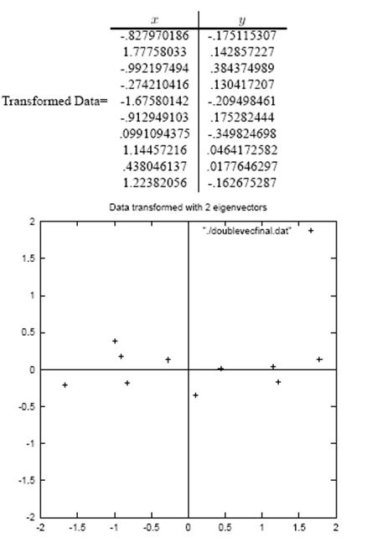
PCA – Simple Procedure
Step 5 – Reduce dimensionality and form feature vector
  Once eigenvectors are found from the covariance matrix, the next step is to order them by eigenvalue, highest to lowest. This gives you the components in order of significance
  With n eigenvalues, choose only the first p to represent you data
  So, the feature vector = (eig₁ eig₂ … eig_{p})
CSCI 6907-12 Big Data and Analytics
4-<number>

Slide 51
Variance & Covariance
Variance measures the spread of data in a data set
  For 1-D data, computation is straightforward
Consider 2-D data: how do each of the dimensions vary with each other
  Data points with two attributes; think of them as x and y, which you can plot on a 2-D graph
  Lots of points makes it difficult to visualize patterns in the data
  Example: # hours studied versus grades obtained
  Yields a number, but what does it mean?
    = 0, the two dimensions are independent of each other
    > 0, two dimensions vary together
    < 0, two dimensions vary in opposition
  With 2-D can usually visualize this result, but 3-D and beyond cannot visualize so need some way to characterize how the different dimension relate to each
Cov(x,y) = Σ (x_{i} –x) (y_{i} – y)/(n-1) for i =1, n
CSCI 6907-12 Big Data and Analytics
4-<number>

Slide 52
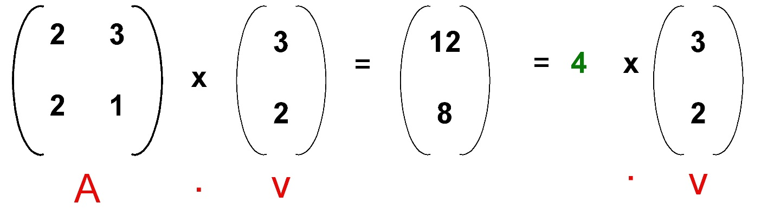

Eigenvalues & Eigenvectors
An eigenvalue problem may be written as a matrix equation:
A . v = λ . v
Any solution for λ is the eigenvalue and v is the eigenvector.
CSCI 6907-12 Big Data and Analytics

Slide 53
Calculating Eigenvalues - I
Suppose we are given: A . v = λ . v
A . v - λ . I . v = 0
(A - λ . I ). v = 0
Finding the roots of |A - λ . I| will give the eigenvalues
Let A = (0 1)
(-2 -3)
Then, (A-λ.I) = (0 1) (λ 0)
(-2 -3) - (0 λ) = 0, then (-λ 1) = λ² + 3λ + 2 = 0
(-2 -3-λ)
So, there are two eigenvalues: λ₁ = -1 and λ₂ = -2
For λ1, the eigenvector is (1 1) (v_{1:1})
(-2 -2) (v_{1:2}) = 0 or v_{1:1} = - v_{1:2}
So, any column vector with components of equal magnitude and opposite sign.
CSCI 6907-12 Big Data and Analytics
4-<number>

Slide 54
Calculating Eigenvalues - II
Therefore eigenvector v₁ is v₁ = k₁ ( +1)
( -1) where k₁ is some constant
And, eigenvector v₂ is v₂ = k₂ (+1)
(-2) where k₂ is some constant
And the eigenvalues are λ₁ = -1 and λ₂ = -2
Eigenvectors can only be found for square matrices; not every square matrix has eigenvectors.
Given an n x n matrix, we can find n eigenvectors
CSCI 6907-12 Big Data and Analytics
4-<number>

